Slide 1
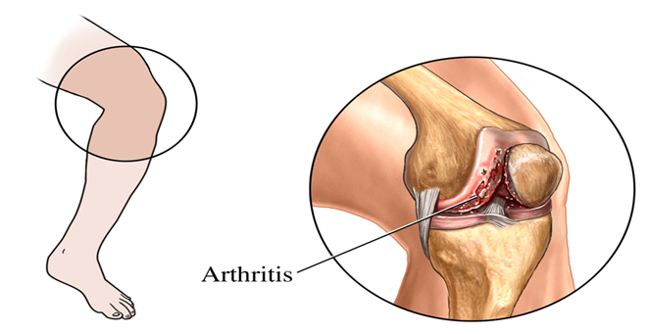
Self-Massage for Osteoarthritis of the Knee
Created by:
  Dorothea V. Atkins RN, M.A., Th.D
  Copyright 2009 Dorothea V. Atkins
  All rights reserved.

Slide 2
Precautions
Do not massage areas of:
  Injury
  Infection
  Open wounds
  Discoloration
  Unusual swelling
The self-massage protocol is not intended as a substitute for medical advice. Stop if undue pain, shortness of breath, or dizziness occurs.
Beginning a new physical activity may cause muscle soreness.
  Copyright 2009 Dorothea V. Atkins
  All rights reserved.

Slide 3
Guidelines for Practice
Each individual’s body is unique, use common sense when following directions, make adjustments when necessary.
Wear comfortable loose clothing which allows easy access to the thigh.
The self-massage session takes approximately.
20 minutes; 5 minute warm-up, 10 minute massage, and 5minute relaxation.
Maintain good posture and balance.
Select a sturdy chair and apply lubricant as needed.
  Copyright 2009 Dorothea V. Atkins
  All rights reserved.

Slide 4
Self-Massage and Strokes
Self-massage is a self-treatment technique for the personal management of conditions or symptoms that respond to touch, manual, soft tissue manipulation or massage therapy.
Strokes used:
  Effleurage (glide) – horizontal strokes on soft tissue using heel of hand.
  Tapotement (tapping) – springy taps to the thigh with closed loose fist.
  Friction- short focused movements with finger tips on the underlying tissue.
  Copyright 2009 Dorothea V. Atkins
  All rights reserved.

Slide 5
Self-Massage Phases
Warm-up- general breathing and movements to warm the muscles and soft tissue.
Application- apply series of easy massage strokes with heel of hand and closed fist to quadriceps (thigh) muscles.
Relaxation- deep breathing.
  Copyright 2009 Dorothea V. Atkins
  All rights reserved.

Slide 6
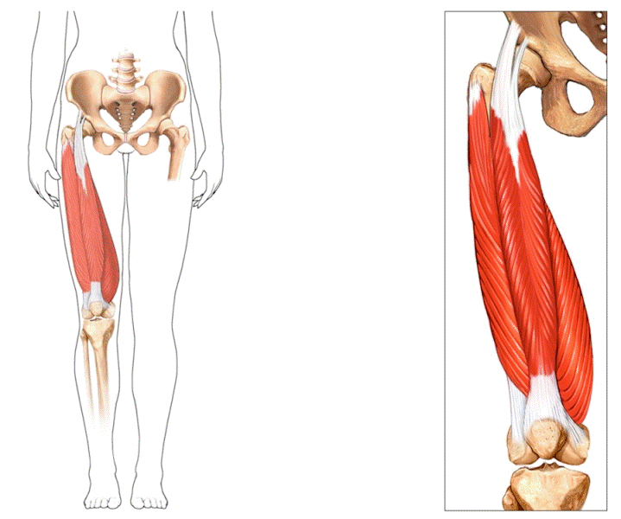
Self-Massage Sequence
Warm-up
Application (Self-Massage)
  Gliding
  Tapping
  Friction strokes
Relaxation
Quadriceps muscle
  Copyright 2009 Dorothea V. Atkins
  All rights reserved.

Slide 7
Warm-Up Phase:
Deep Breathing
3 deep breaths
Inhale naturally to the count of four
Exhale to the count of four
  Copyright 2009 Dorothea V. Atkins
  All rights reserved.

Slide 8
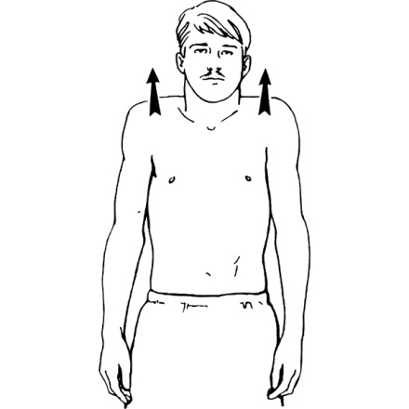

Warm-Up Phase:
Shoulder Shrug
Raise right shoulder three times
Raise left shoulder three times
Raise both shoulders together three times
  Copyright 2009 Dorothea V. Atkins
  All rights reserved.

Slide 9
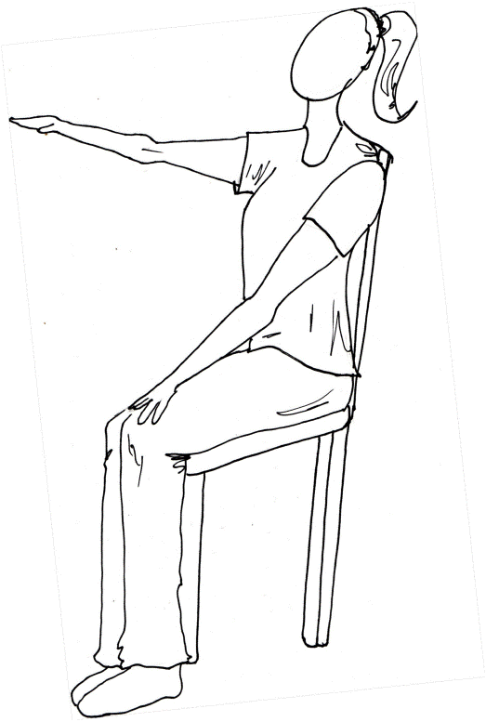
Warm-Up Phase:
Arm Reaches
Raise right arm to front shoulder height
Lower right arm to lap
Raise left arm front to shoulder height
Lower left arm to lap
Repeat two more times
  Copyright 2009 Dorothea V. Atkins
  All rights reserved.

Slide 10
Warm-Up Phase:
Arm Raises
Inhale
  Raise right arm to ceiling
Exhale
  Lower right arm to side
Inhale
  Raise left arm to ceiling
Exhale
  Lower left arm to side
Repeat two more times
  Copyright 2009 Dorothea V. Atkins
  All rights reserved.

Slide 11
Warm-Up Phase:
Wrist Circles
Sit with elbows tucked at waist
Forearms out in front (waist height)
Palms facing down
Circle right wrist five times
Circle left wrist five times
  Copyright 2009 Dorothea V. Atkins
  All rights reserved.

Slide 12
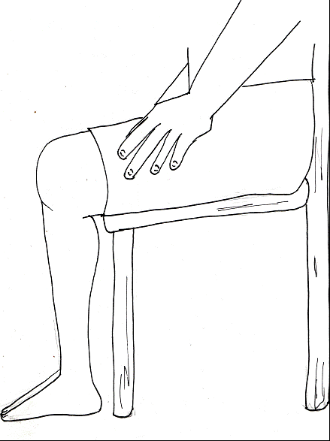

Warm-Up Phase:
Thigh Muscle
Hands on top of thigh
Raise right knee
  Hold for a count of three
  Lower to floor
Raise left knee
  Hold for a count of three
  Lower to floor
Repeat four more times
  Copyright 2009 Dorothea V. Atkins
  All rights reserved.

Slide 13
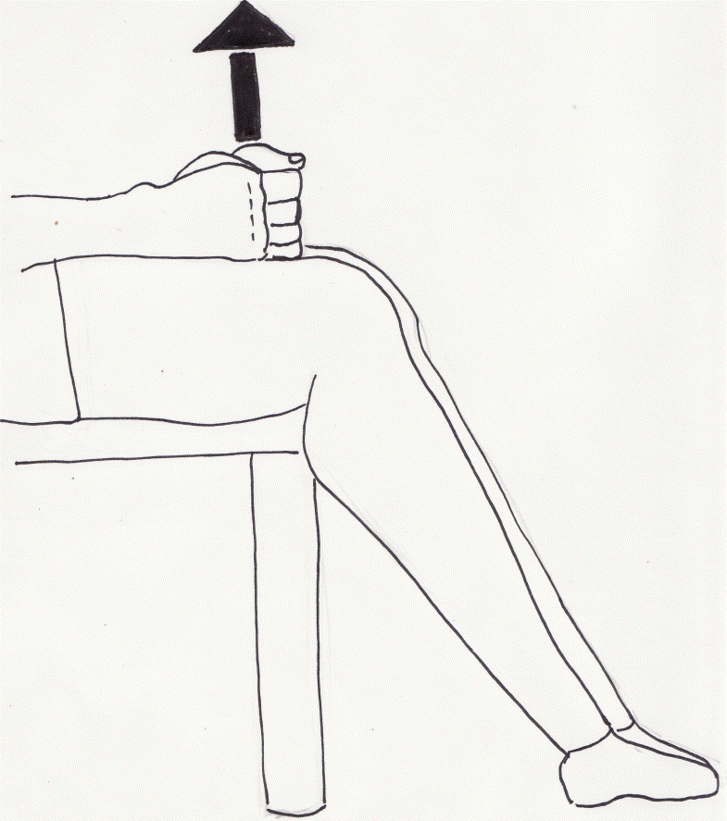
Application:
Tapotement /Tapping Thigh
With soft closed fists
Rhythmically tap both fists to the top of both thighs:
  Upper- times 10
  Middle- times 10
  Lower-times 10
Repeat once more
Take three deep breaths
  Copyright 2009 Dorothea V. Atkins
  All rights reserved.

Slide 14
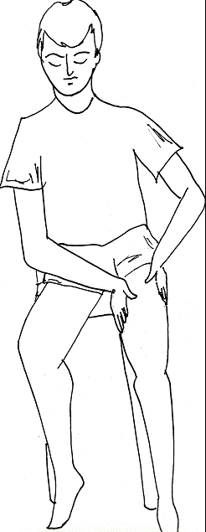
Application of Lubricant
Apply lotion or cream to both thighs
  Copyright 2009 Dorothea V. Atkins
  All rights reserved.

Slide 15
Key Concepts for Application of Self-Massage
Rocking - forward and backward motion
with each stroke using heel of hand.
2. Reposition- sit forward, extend
lower leg.
  Copyright 2009 Dorothea V. Atkins
  All rights reserved.

Slide 16
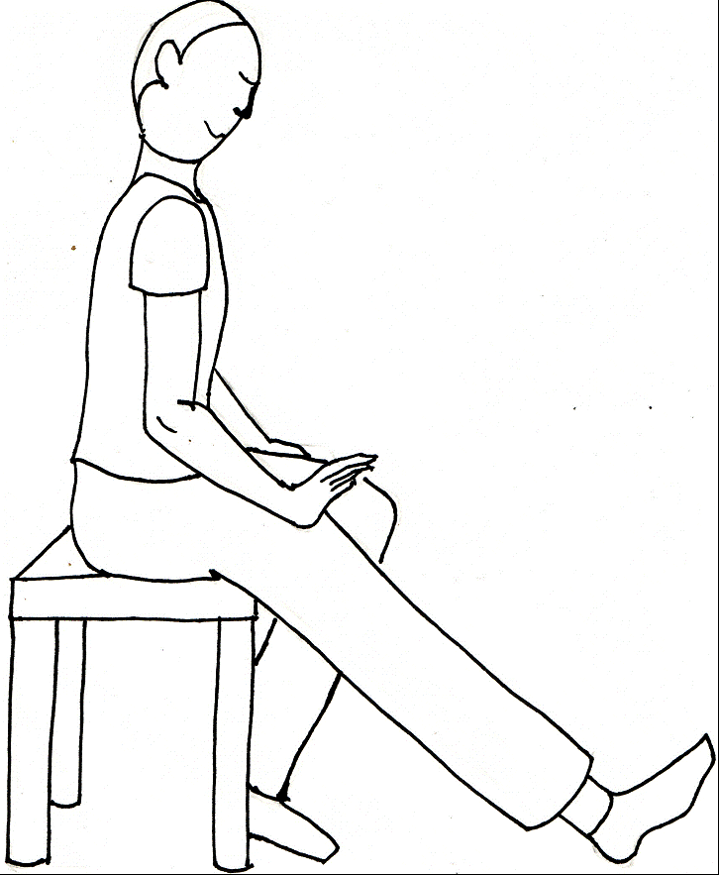
Application:
Front Glide of Right Thigh
Place heel of hand at hip crease
Glide down front of thigh using heel of hand, shift upper body into a forward lean (rocking forward) until stroke is complete
End at top of knee
Release hand sweep up, rocking backward into upright sitting position
Repeat four more times
  Copyright 2009 Dorothea V. Atkins
  All rights reserved.

Slide 17
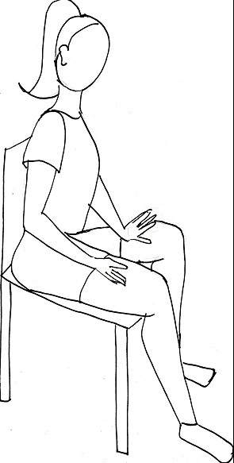
Application:
Outside Glide of Right Thigh
Place heel of hand at top of outside thigh
Glide down to knee. Rocking forward
Release
Sweep up-rock backward
Repeat four more times
  Copyright 2009 Dorothea V. Atkins
  All rights reserved.

Slide 18
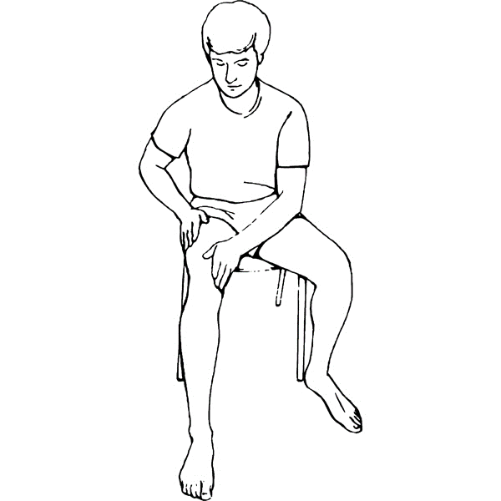
Application:
Inner Glide of Right Thigh
Place heel of left hand on inner right thigh
Glide down to knee- rock forward
Release
Sweep up- rock backward
Repeat four more times
Take three deep breaths
  Copyright 2009 Dorothea V. Atkins
  All rights reserved.

Slide 19
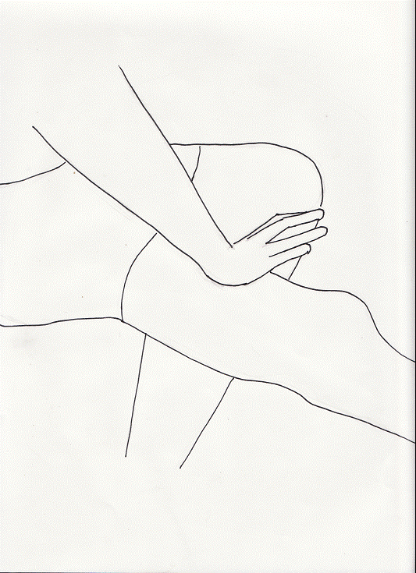
Application:
Front Glide of Left Thigh
Place heel of hand at crease of pants
Glide down front of thigh using heel of hand, rock forward
Release hand, sweep up, rocking backward into upright sitting position
Repeat four more times
  Copyright 2009 Dorothea V. Atkins
  All rights reserved.

Slide 20
Application:
Outside Glide of Left Thigh
Place heel of hand at top of outside thigh
Glide down to knee, rock forward
Release
Sweep up, rock back
Repeat four more times
  Copyright 2009 Dorothea V. Atkins
  All rights reserved.

Slide 21
Application:
Inner Glide of Left Thigh
Place heel of right hand on inner left thigh
Glide down to knee, rock forward
Release
Sweep up, rock back
Repeat four more times
Take three deep breaths
  Copyright 2009 Dorothea V. Atkins
  All rights reserved.

Slide 22
Application:
Outside Glide of Left Thigh
Place heel of hand at top of outside thigh
Glide down to knee, rock forward
Release
Sweep up, rock back
Repeat four more times
  Copyright 2009 Dorothea V. Atkins
  All rights reserved.

Slide 23
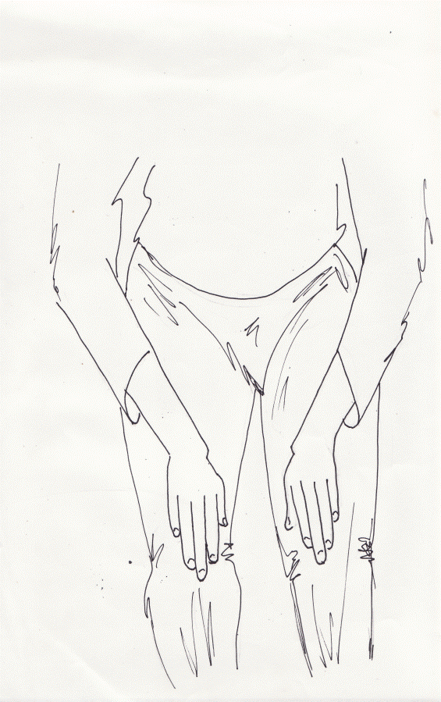
Application:
Knee Friction
Place palm over knee, finger tips compressed firmly into tissue
Five strokes back and forth motion:
  Below the knees
  Outer part of knees
  Top of knees
  Inner part of knees
Repeat two more times
  Copyright 2009 Dorothea V. Atkins
  All rights reserved.

Slide 24
Application:
Glide Stroke
Place palms on each thigh, fingers forward
Glide down around knee to outside thigh
Repeat two more times
Glide down inner thigh
Sweep around knee to outside thigh
Repeat two more times
Take three breaths
  Copyright 2009 Dorothea V. Atkins
  All rights reserved.

Slide 25
Relaxation – Breath Work
Sit comfortably
Close your eyes
Inhale for four counts
Exhale for four counts
Repeat two more times
  Copyright 2009 Dorothea V. Atkins
  All rights reserved.

